Slide 1


toRonto City PostalCode analysis ReportsdfdsgsdTorTTor
Tor

Slide 2
Description of the problem and discussion of background
In this assignment, I had to explore, segment, and cluster the neighborhoods in the city of Toronto. However, unlike a previous case we did about New York, the neighborhood data is not readily available on the internet. What is interesting about the field of data science is that each project can be challenging in its unique way, so you need to learn to be agile and refine the skill to learn new libraries and tools quickly depending on the project.

Slide 3

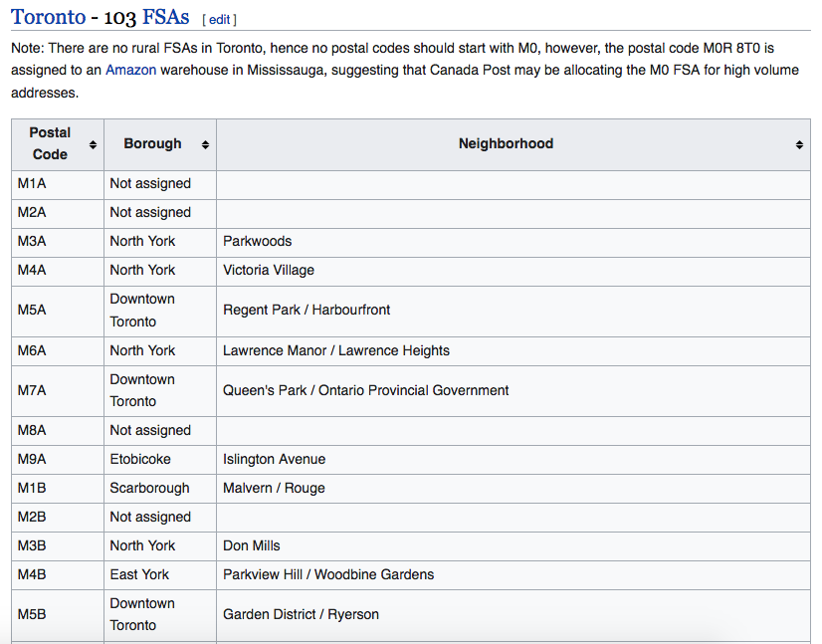
Description of the data and how it was used to solve the problem
The list that was used was provided by the Canadian Government and can be found on Wikipedia through this link:
https://en.wikipedia.org/wiki/List_of_postal_codes_of_Canada:_M

Slide 4
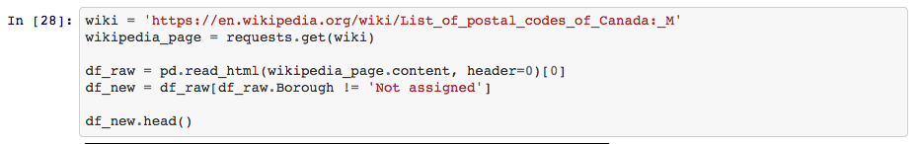

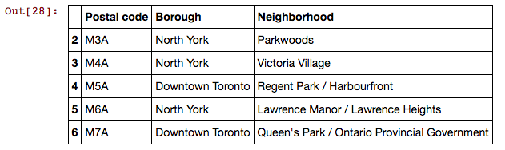
Methodology section representing main components
The data was downloaded from Wikipedia into the Notebook.
There I decided to look at it first in a global way by looking for its shape.

Slide 5
Results and Discussion
The results show all the different Neighborhoods from Toronto with a PostalCode starting with the letter MXX and the according coordinates. You can see on the graph where they are located along the city and which Borough belongs there.
According to the results it is possible to observe and see where certain Neighborhoods end and where they overlap. It is recommended for companies or individuals interested in specific Boroughs or Neighborhoods to observe the map.

Slide 6
Conclusion
The purpose of this report was to analyze and categorize different Neighborhoods in Toronto and map them out. It was possible to build a map showing different Neighborhoods within the city of Toronto starting with a PostalCode with the letter MXX.

